Slide 1
Mapping the Journey to BFI Designation & Re-designation

Slide 2
Presentation prepared by:
Marg La Salle RN, BScN, IBCLC
Lead Assessor, Breastfeeding Committee for Canada
Co-chair, BFI Assessment Committee, Breastfeeding Committee for Canada
BFI Assessment Coordinator, Baby-Friendly Initiative Ontario

Slide 3
Presentation Objectives
Increase familiarity with the Breastfeeding Committee for Canada (BCC) and the Baby-Friendly Initiative
Review the BCC’s procedure to facilitate continuous quality improvement and accountability
Highlight strategies to prepare for BFI designation/redesignation
Discuss the value of BFI designation/redesignation

Slide 4
Breastfeeding Committee for Canada (BCC)
Established in 1991
Registered not for profit organization
BCC Mission: Protect, promote and support breastfeeding in Canada
BCC Vision: Canadian children are breastfed

Slide 5
Breastfeeding Committee for Canada (BCC)
National authority for the Baby-Friendly Initiative (BFI)
Application of the international BFHI standards within the Canadian context
Standards for both hospitals/birthing centres and community health services (CHS)

Slide 6
Breastfeeding Committee for Canada (BCC)
Resources and tools to implement BFI and help facilities with the BFI journey available on the BCC website under the Baby-Friendly Initiative tab

Slide 7
BCC Resources
BFI Implementation Guideline
BFI Guideline Checklist
Medical Indications for Supplementation
Competency Verification Tools
Patient/Client Survey
Chart Audit Manual

Slide 8
What is the Baby-Friendly Initiative?
Core Intent
Ensure that mothers and infants receive timely and appropriate care prenatally, at birth, during their stay at a hospital/birthing centre and once discharged home
Enable the establishment of optimal feeding of babies
Protect, promote and support breastfeeding through the provision of timely and appropriate care
Facilitate informed decision-making when infant formula is needed for medical or personal reasons and provide timely and appropriate care for families that feed infant formula

Slide 9
The Ten Steps to Successful Breastfeeding in Canada

Slide 10
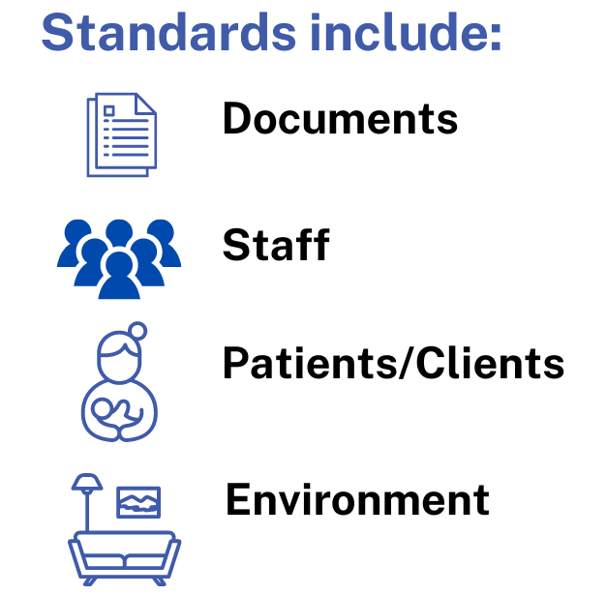
Each Step has Standards

Slide 11
BFI Standards
2021

Slide 12
BFI Processes and Costs
https://breastfeedingcanada.ca/wp-content/uploads/2022/08/BCC-Process-and-Cost-doc-July-2022-clean-copy.pdf

Slide 13
Maintenance After BFI Designation

Slide 15
Preparing for BFI Designation
Facility Self-appraisal
Table 1 of the BFI
Implementation Guideline
BFI Guideline Checklist

Slide 16
Preparing for BFI Designation
Use findings from facility self-appraisal to create an action plan
Multidisciplinary team
Seek help as needed
You may wish to participate in the BCC’s coach mentor program!

Slide 17
Preparing for BFI Designation
Creating the action plan
Quality Improvement Process
Focus on the standards that need strengthening
Set goals that are SMART

Slide 18
Preparing for BFI Designation
Implementing the action plan
Celebrate successes – both large and small
Review facility self-appraisal
Check that standards for each step are being met

Slide 19
Readiness for Pre-assessment
Contact the BCC for Pre-assessment contract
If facility is being assessed for re-designation, decide if a Pre-assessment site visit is wanted
Prepare documents for review

Slide 20
Readiness for External Assessment
Contact the BCC for an
External Assessment contract
Determine mutually agreeable site visit dates
Prepare staff and families for visit by the External Assessment Team

Slide 21
External Assessment Outcome
BFI Designation
Facility meets requirements for all steps
Conditional BFI Designation
Some steps don’t meet the standards
Certificate of Commitment
A formal recognition of progress made towards BFI designation
Valid for 1 year

Slide 22
Importance of
BFI Designation

Slide 23
Importance of
BFI Designation

Slide 24
Thank you!

